Slide 1
Predicting Viable Stem Cells after Freeze-Thaw
BMIN503 Final Project
Stephan Kadauke
Assistant Director, CHOP Cell and Gene Therapy Lab (CGTL)

Slide 2
Background
Hematopoietic stem cell (HSC) transplant is life-saving therapy for various malignant and non-malignant diseases.
In autologous HSC transplants, cells are collected from a patient prior to high-dose chemotherapy and reinfused later.
Therefore, HSC products for autologous transplantation need to be cryopreserved and thawed before infusion.

Slide 3
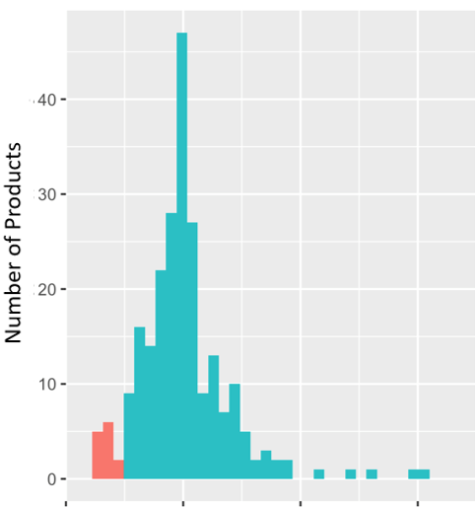
Viability of Stem Cells after Freeze-Thaw
CD34 is a marker to identify HSCs
We found that % of CD34+ HSCs remaining after freeze-thaw varies widely
Why does this matter? Insufficient numbers of HSCs can lead to delayed engraftment or graft failure
Potentially fatal complication of HSC transplant
0
50
100
200
300
Percentage of vCD34 % Remaining after Freeze-Thaw
Red indicates collections incurring >50% drop in the percentage of CD34+ cells

Slide 4
Aim of the Study and Approach
The aim of this study is to determine if a low post-thaw viability can be predicted from clinical and lab parameters that are available prior to cryopreservation.
I used data from CHOP patients who have had autologous stem cell products collected in the CGTL since 2016.
I used the {tidymodels} framework to train and tune various machine learning models using a train/test split and resampling strategy.
The model is meant to predict poor recovery, defined as a product in which the post-thaw viability was found to be <70% of the viability in the fresh product.

Slide 5
Data
N=235 autologous HSC products
24 predictors and 1 outcome variable
Few missing values
Split 80/20 into train/test

Slide 6
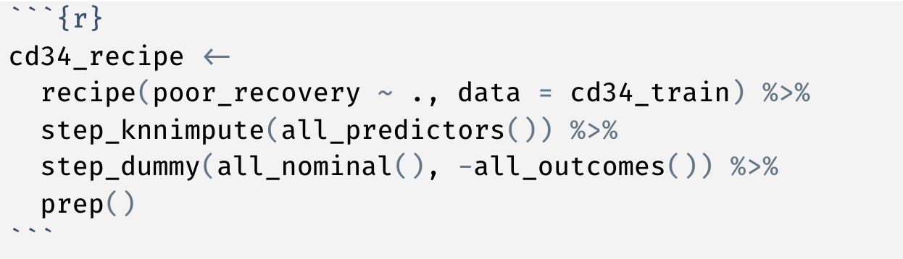
Feature engineering
Notes:
1. We will use K-nearest neighbor imputation to deal with missing values.
2. Since XGBoost cannot handle factor variables, we will convert all character/factors to dummy variables.

Slide 7
Initial models
Metric* | Random Forest | K Nearest Neighbor | XGBoost
Accuracy | 0.82 | 0.76 | 0.76
ROC AUC | 0.71 | 0.61 | 0.67
*All metrics are 10-fold cross-validated means

Slide 8
Tuning the Random Forest model
Random grid search across all 3 hyperparameters
No great improvement –best model had ROC AUC = 0.72

Slide 9
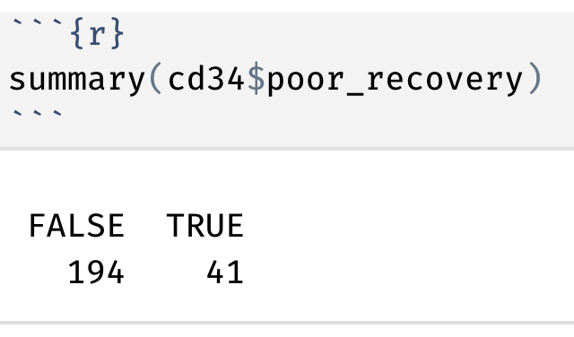
Class imbalance?

Slide 10
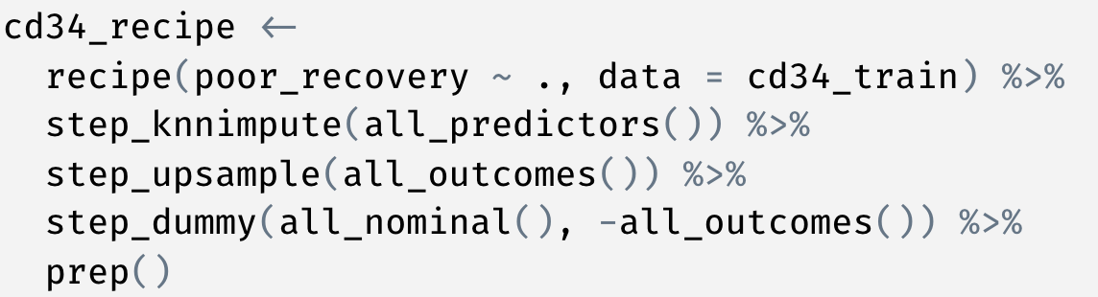
Revised feature engineering recipe

Slide 11
Initial models
Metric* | Random Forest | K Nearest Neighbor | XGBoost
Accuracy | 0.82 | 0.76 | 0.76
ROC AUC | 0.71 | 0.61 | 0.67
With upsampling
Metric* | Random Forest | K Nearest Neighbor | XGBoost
Accuracy | 0.80 | 0.69 | 0.71
ROC AUC | 0.72 | 0.61 | 0.68
*All metrics are 10-fold cross-validated means

Slide 12
Tuning the upsampled RF model
ROC AUC is still 0.72 ☹

Slide 13
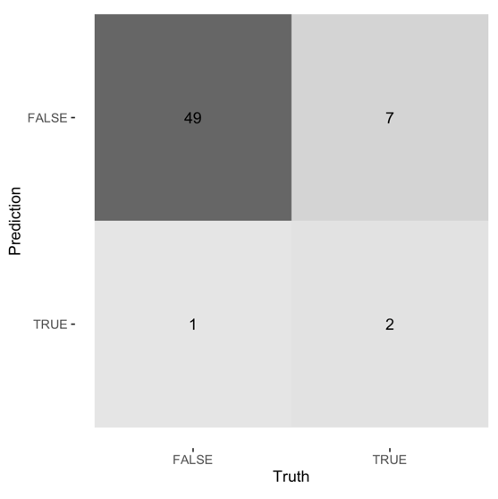
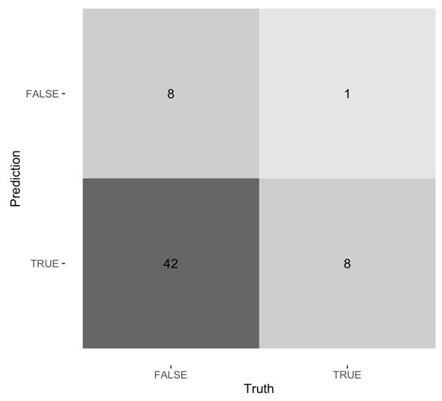
Evaluating the model on the test data
Test ROC AUC = 0.65
Lots of false negatives (falsely reassuring predictions)
FPR threshold -> 0.05

Slide 14
Conclusions
Various models were created to predict post thaw viability of autologous HSCs
The best model was a tuned random forest with mean ROC AUC of 0.72 in 10-fold cross-validated training data
On the test data, this model reached an ROC AUC of 0.65
The model’s predictive accuracy is currently not sufficient to be clinically useful.

